Slide 1
WELCOME, ONBOARD … 🚀🎯

Slide 2
WEBMONK- MERN STACK
Topics covered:
Who are we * What course is about *Peer Introduction
*how to ask for help, pre-requisite, course-outline, tasks-overview.
** What is MERN stack, it's alternative, it's future, scope.

Slide 3



WHO ARE WE?
ALOK RAJ
MIHIR KUMAR
SRAVAN KUMAR

Slide 4
WHAT COURSE IS ALL ABOUT❓

Slide 5
PEER INTRODUCTION .. 👀

Slide 6
COURSE OUTLINE **

Slide 7
WHAT IS MERN STACK❓

Slide 8
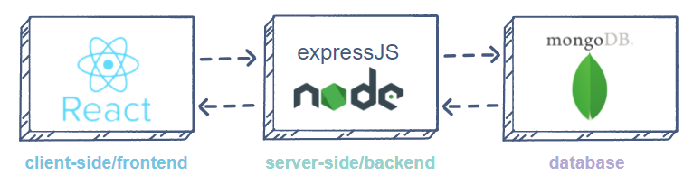
MERN stack is a web development framework. It consists of MongoDB, ExpressJs, ReactJS, and NodeJS as its working components.
MongoDB: A document-oriented, No-SQL database used to store the application data.
NodeJS: The JavaScript runtime environment. It is used to run JavaScript on a machine rather than in a browser.
ExpressJs: A framework layered on top of NodeJS, used to build the backend of a site using NodeJS functions and structures. Since NodeJS was not developed to make websites but rather run JavaScript on a machine, ExpressJs was developed.
ReactJS: A library created by Facebook. It is used to build UI components that create the user interface of the single page web application.

Slide 9
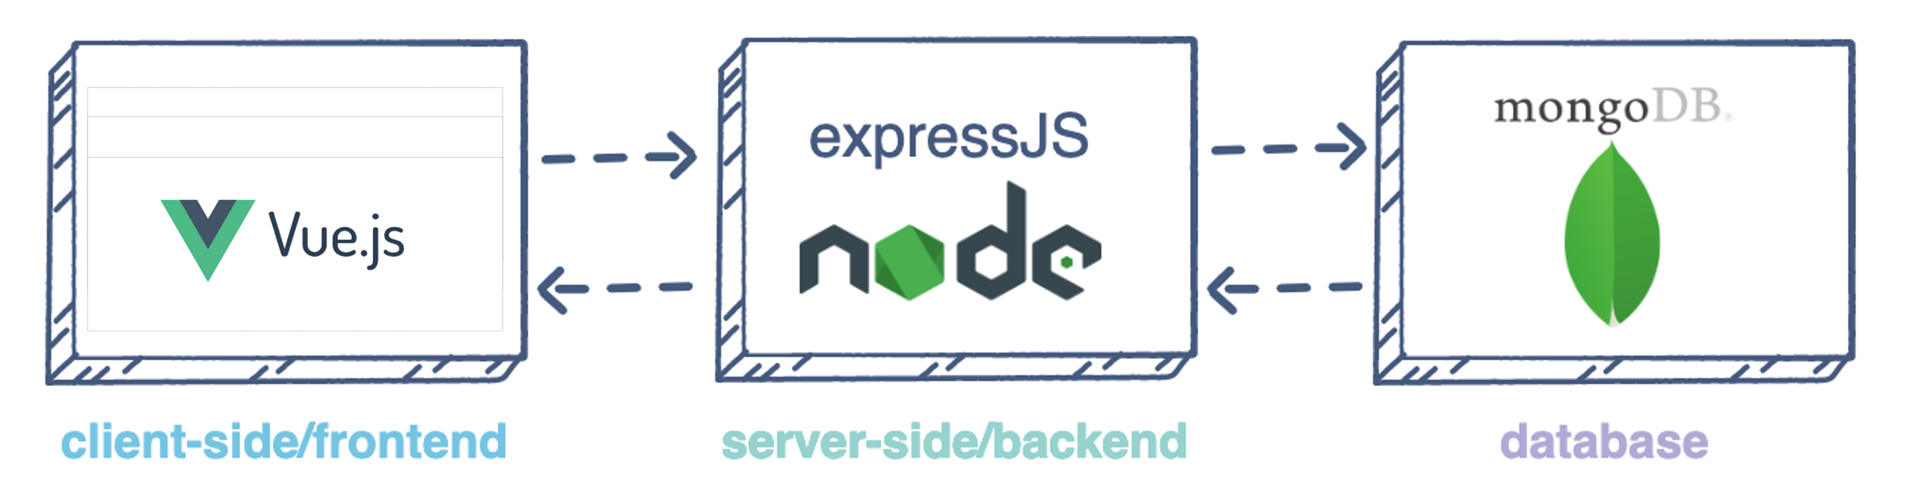
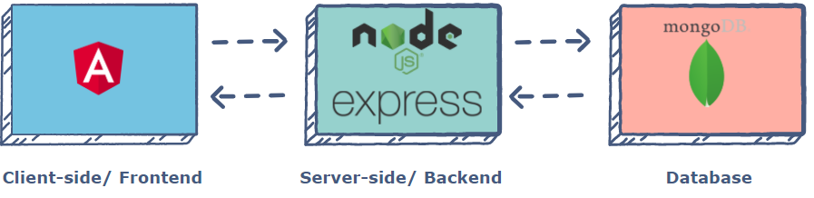
ALTERNATIVES TO MERN STACK
MEVN
MEAN

Slide 10
Some prerequisites
HTML - https://www.youtube.com/watch?v=pQN-pnXPaVg
CSS - https://www.youtube.com/watch?v=ieTHC78giGQ
And willingness to learn!

Slide 11
THANK YOU, HAPPY CODING … 💻

